Slide 1
Digital Marketing Plan of Automobile Companies on TikTok Live Streaming
Yue Mao
04/28/2022

Slide 2
Applied Project
Presentation in fulfillment of requirements of the NYU SPS course
Applied Project: Capstone
Spring 2022

Slide 3
Project Sponsor and Project Goal
Project Name: Digital Marketing Plan of Automobile Companies on TikTok Live Streaming
Client Organization: ByteDance
Client Sponsoring Professional and Title:
ChongYang Fan, Advanced Marketing Manager in ByteDance
Project Goal: The project goal is providing a digital marketing plan for automobile companies on TikTok livestreaming platform and creating a promotion website.

Slide 4
What did the project needed to achieve?
Four objectives of this project
Object 1 – Write a live streaming industry trend analysis and calculate data from financial statements. Use Tableau to analyze data.
Object 2 – Have cases and surveys in some typical automobile companies to find traditional automobile companies’ marketing problems.
Object 3 – Provide a digital marketing plan for automobile companies in TikTok live streaming to attract more customers.
Object 4 - Create a website to promote automobile customers’ marketing plan in TikTok live streaming and provide the appointment system for users.

Slide 5
What needed to be done?
Project Assignments, including Project Proposal, Literature Review, Work Breakdown Sturcture, Change Management Plan, Risk Analysis Plan and Status Report.
Industry analysis, including livestreaming industry and situation of automobile companies.
Analyze cases and surveys in typical automobile companies.
Provide two alternate marketing solutions and compare more effective method.
Create a promotion website for automobile marketing on TikTok platform, including essential infomration in this project.

Slide 6
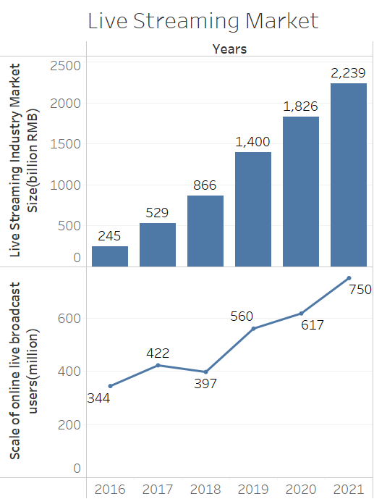
Industry Analysis
During the pandemic period, users spend more time online. More and more people watch live streaming and shop online.
Driven by live streaming e-commerce, the live streaming industry market size has explosive growth.
In the past five years, users of online live streaming have also experienced great growth. From 344 million in 2016 to 750 million in 2021.

Slide 7
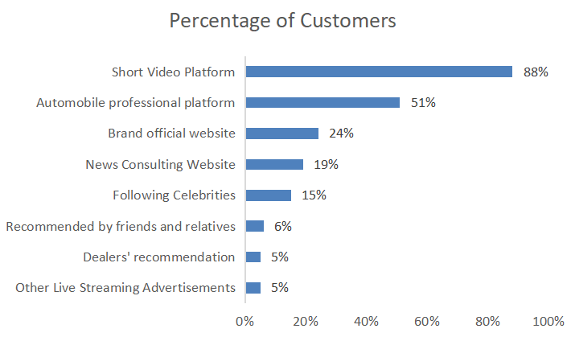
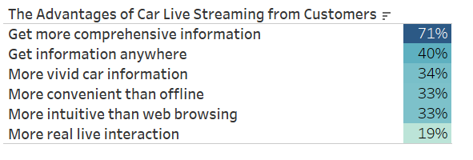
Industry Analysis
According to the survey data, short video platforms and automobile professional platforms are the main ways for users to understand and watch automobile live streaming, and short video platforms account for more than 80%.
According to the customer data in surveys, most users believe that automobile live streaming has convience in various aspects.

Slide 8
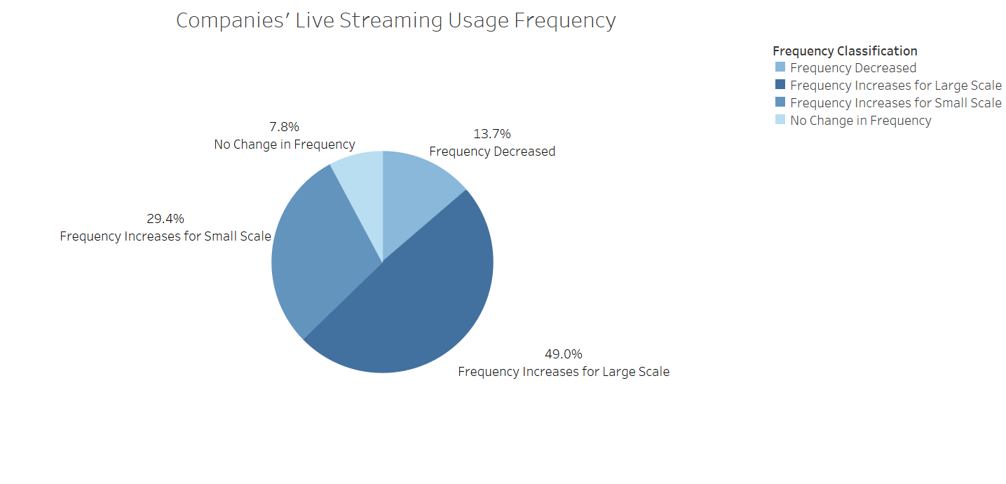
Industry Analysis
Many companies have realized the importance of normalized live streaming. In 2022, nearly 70% of corporate customers said that the frequency of their company's live broadcasts has further increased, and 49.0% of corporate customers said that their live broadcast frequency has increased significantly.

Slide 9
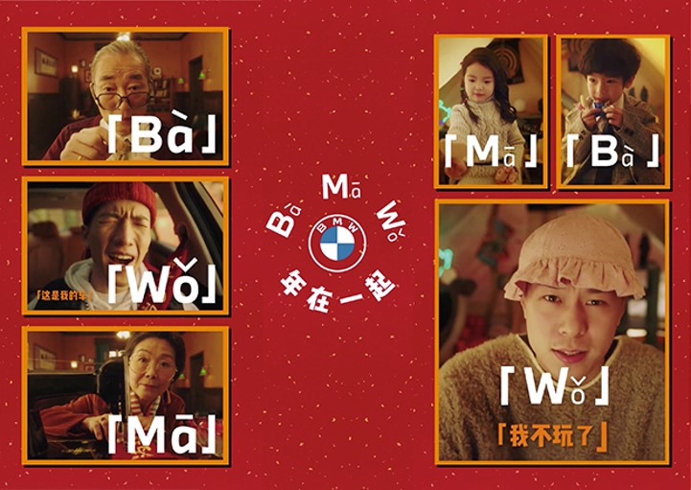
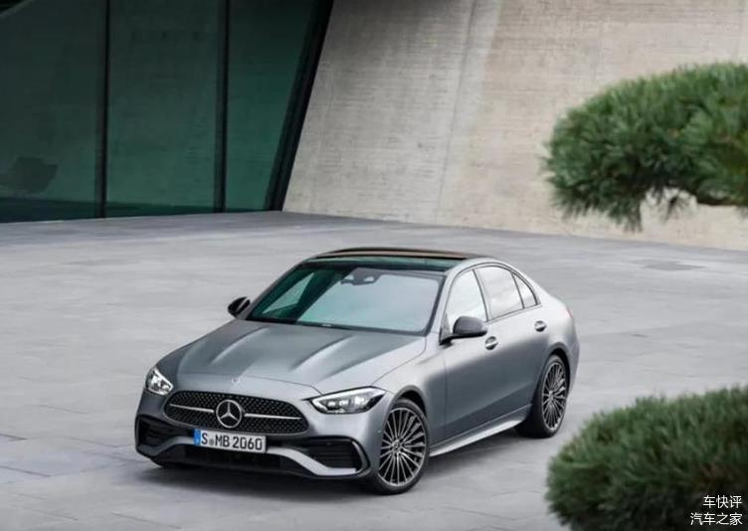
Cases and Surveys
BMW used homonyms in Chinese dialects for creative contents on TikTok platform. This marketing plan achieved 93% increase in exposure, and 75,000 BMW official account fans increased.
Mercedes-Benz chose to cooperate with the TikTok platform and invited a celebrity director to make a marketing short videos. This marketing plan reaching a total of 510 million total topic views, 117,000 total videos and 13.13 million video likes, truly realizing user fission marketing.
Local automobile dealers open their TikTok enterprise accounts and conduct live streaming marketing.

Slide 10
Alternate Solutions
Automobile companies have two main advertisement marketing solutions on the TikTok platform.
Alternate Solutions | Business Function Evaluation | Cost Evaluation
Short Video with Celebrity Marketing Plan | Got exposure from influence of celebrity | Additional short video cooperation payment
Car Cloud Store Live Streaming Marketing Plan | Have efficient contact with customers | Commission payment and the promotion fee on TikTok

Slide 11
Problem and Opportunities
The most important issue for automobile companies at this stage is how to achieve more effective user conversions.
Customer information in different places is not being used effectively during automobile live streaming.
Automobile companies need a new marketing method to improve the marketing efficiency of live streaming and improve the information retention rate of customers in live streaming.

Slide 12
Details of Final Marketing Plan
Automobile companies could connect to their dealer stores across the country, each dealer will open its own live streaming account and directly interact with users.
This live streaming marketing method could distribute user data from different regions into their local dealer information system.
Automobile Dealers on TikTok Live Streaming Process

Slide 13
Details of Final Marketing Plan
Many automobile companies and dealer stores open their own TikTok accounts to operate their private domain customers.
In the live streaming room, professional car sales could better interact with users, establish contacts, and get effective client appointments.
Automobile dealers can forward the clues from different locations to the manufacturer, and the system automatically help manufactuers send customer clue information to local automobile dealers.
80% of the different location customer clues changed from invalid to effective.
Live streaming marketing plan is co-created by manufacturers and dealers, which is regionally accurate, enabling in-depth communication between automobile companies and customers.

Slide 14
Results
Project report, website, Risk analysis plan, Change management plan
Industry research and surveys found that many automobile companies are exploring online marketing methods.
A creative marketing plan that greatly improve the sales volume of automobile companies.
Automobile clients are very satisfied with this new marketing plan. The number of automobile dealers who have cooperate with live streaming on the TikTok platform has reached nearly 5,000 covering nearly 80 brands.
A promotion website was created during this project, including organization introduction, marketing plan description and customer appointment systems.

Slide 15
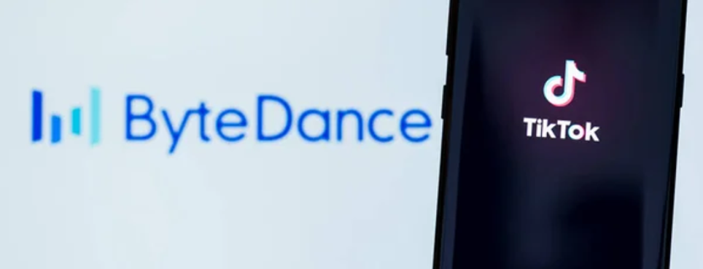
Promotion Website
The promotion website created during this project contains a detailed introduction to the organization and contents of TikTok automobile livestreaming marketing plan.
This website includes the live streaming process of automobile companies and the screenshots of car dealer's live streaming page.
This website also has a system for users to register and submit their contact information.
The details of website could be linked at: https://ym2157.wixsite.com/tiktokautomobile

Slide 16
Conclusions and Recommendations
This project achieves the project goal and meet main objectives.
What are next steps?
Future work will follow up the situation of the user data and give feedback to the automobile customer companies.
The project department will also collect user feedback to test the final effect of the marketing plan.
Test the revenue increase of automobile company's during this marketing plan.

Slide 17
Thank you
Yue Mao
Master student in NYU Management and Systems program
Your Linked-In contact information:
http://linkedin.com/in/yue-mao-7b4b88199
ym2157@nyu.edu

